Slide 1
Ruby profiling
David Grayson
Las Vegas Ruby Meetup
2013-08-28

Slide 2
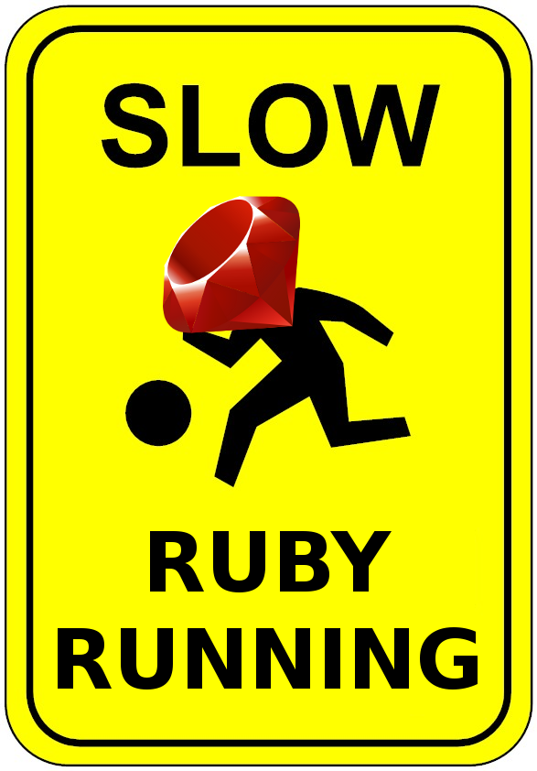

Slide 3
Two profiling tools
ruby-prof
rblineprof

Slide 4
Features of ruby-prof
Speed
Can measure:
  call times
  memory usage
  object allocations
Text and HTML reports:
  Flat profiles
  Graph profiles
  Call tree profiles for KCacheGrind
Supports multiple threads

Slide 5
Example ruby-prof profiles

Slide 6
ruby-prof executable
ruby-prof slow_program.rb
ruby-prof --file=profile.html \
--printer=graph_html \
slow_program.rb

Slide 7
ruby-prof API
require 'ruby-prof'
RubyProf.start
slow_code
result = RubyProf.stop
File.open("slow2.txt","w") do |file|
RubyProf::GraphPrinter.new(result).print(file)
end

Slide 8
Excluding methods in ruby-prof
New!
Exclude methods by class/method name or regular expression.
Remove useless things like Integer#times from reports.

Slide 9
rblineprof
652-line ruby extension written in C
Seems to report the time spent on each line.
No documentation, no report formatting

Slide 10
| class Foo
| def x
2112.8ms 2112.3ms 3 | y; z; z
| end
|
| def y
2031.6ms 2031.2ms 51 | 50.times { z }
| end
|
| def z
14.7ms 14.6ms 52 | waste_cpu 0
2096.0ms 2095.6ms 52 | waste_cpu 0.04
| end
|
| def waste_cpu(seconds)
5.1ms 5.1ms 312 | start = Time.now
1875.4ms 1876.4ms 109375 | while(Time.now - start < seconds); end
| end
| end
|
| require 'rblineprof'
| profile = lineprof(/./) do
2112.9ms 2112.4ms 3 | Foo.new.x
| end
|
| File.readlines(__FILE__).each_with_index do |line, num|
| sample = profile[__FILE__][num+1]
| if sample[0] > 0
| sample_data = sprintf "%8.1fms %8.1fms %7d",
| sample[0]/1000.0, sample[1]/1000.0, sample[2], line
| end
| printf "%30s | %s", sample_data, line
| end

Slide 11
References
ruby-prof
  https://github.com/ruby-prof/ruby-prof/
rblineprof
  https://github.com/tmm1/rblineprof
  https://github.com/blog/1475-escape-velocity

